Slide 1
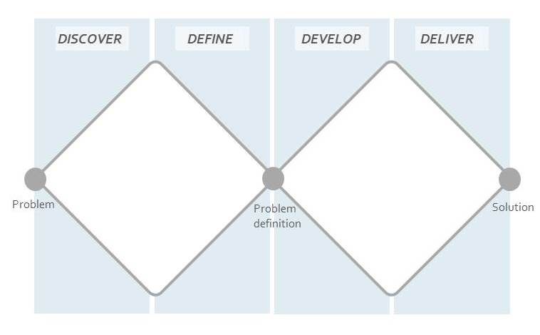
DOUBLE DIAMOND INNOVATION
Notes:
##-AccessibilityAssistant: Skip layout check-##

